Slide 1

UBS DATATHON 2024
Lisan al Gaid

Slide 2
Problem Statement
Parts of the challenge
Find/create/engineer a metric to judge companies
Find external values to predict likes or the outcome variables
Finding Groups or companies that have unique patterns

Slide 3

Data Processing Pipeline
Data cleaning and preprocessing:
EDA
Preprocessing and cleaning
Assumptions:
Data
Structure
Feature engineering and data augmentation:
Engineering from the given data set
Additions from outside data sources

Slide 4
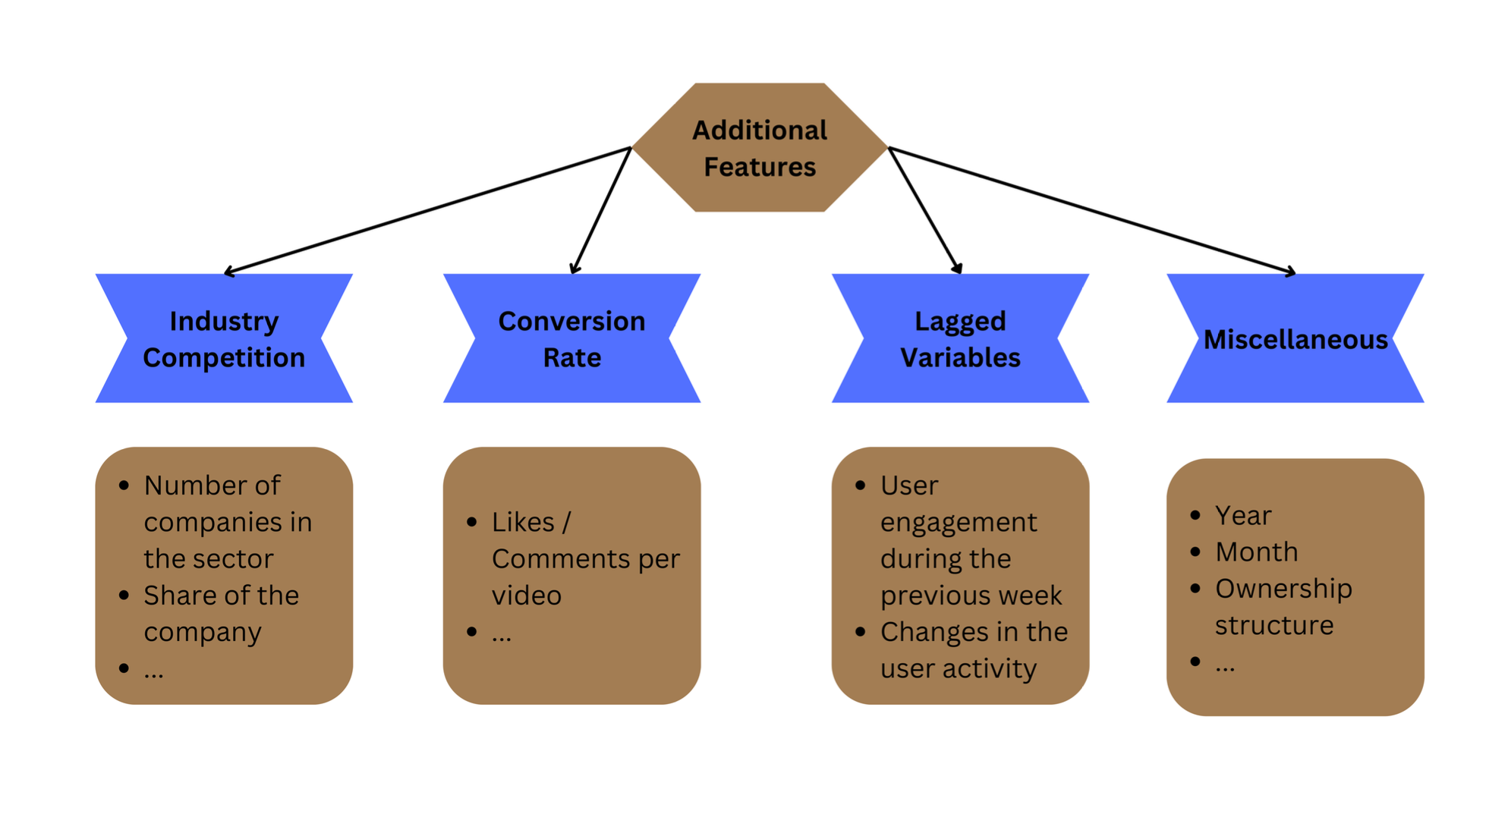
Feature Engineering

Slide 5
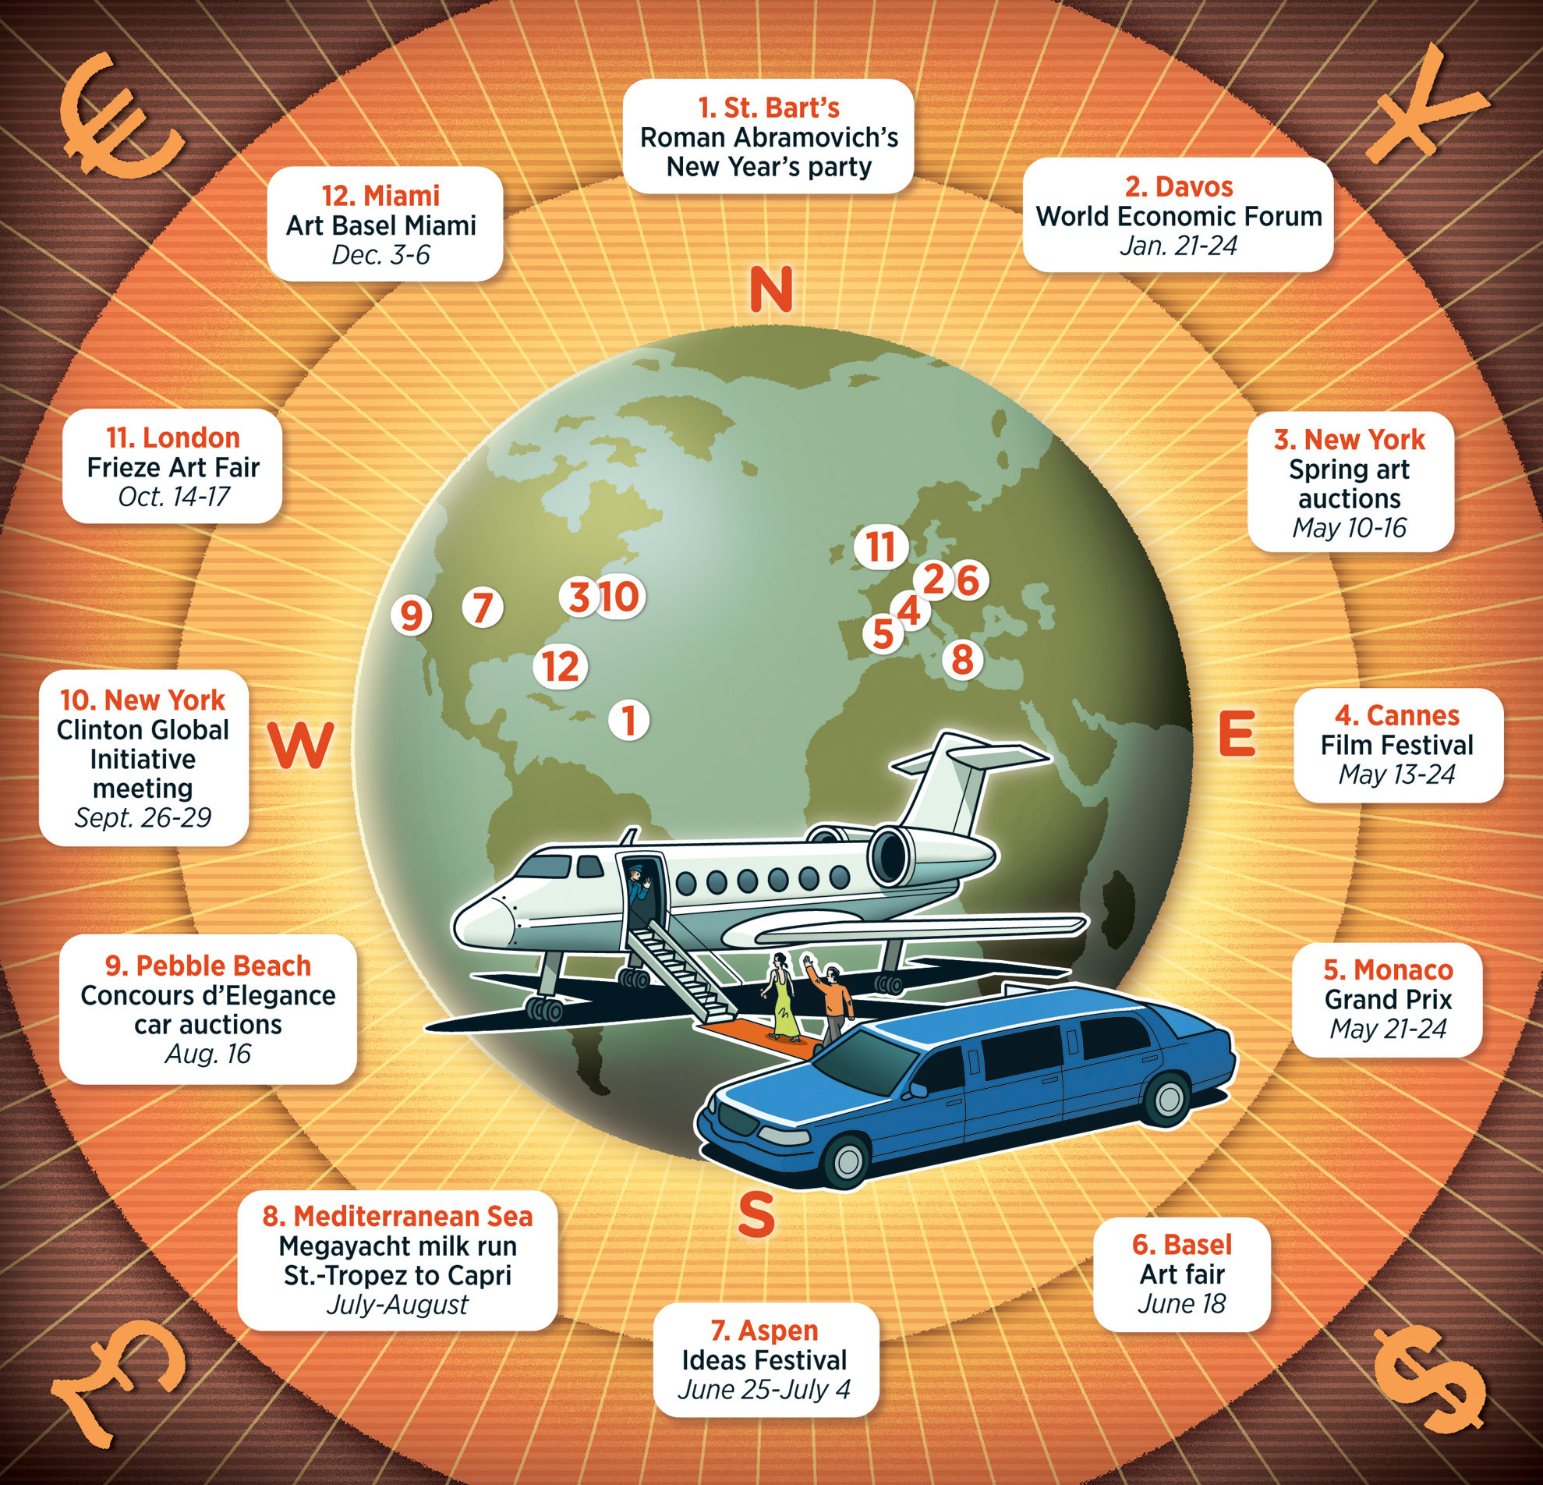

Feature Enhancement
Billionaires calendar
When will they buy the luxury goods?
Macroeconomics
What is the general state of economy
Notes:
The men and women with the most money in the world control the luxury market and during the most exclusive events across the world they look toward luxury brand to provide an high end faction and experience. They will pay extraordinary money to get a priceless experience. We looked for a uptick in activity during these highly publicized events where brands show their best work

Slide 6

Modeling Approach
XGboost / Regression
DBScan
Local Outlier Factor

Slide 7

BIG PICTURE
Time of year
Location and Economic standing
Prophets

